Slide 1
How to send a customized letter to a set of users
Yoel Kortick
Senior Librarian

Slide 2

Agenda
Introduction
Step 1 Define the specific user notification
Step 2 Define messages for letter
Step 3 Edit the XSL of the letter
Step 4 Define a set of users to receive letter
Step 5 Run the job "Update/Notify Users"

Slide 3
Introduction

Slide 4
Introduction
In the example here we will send a letter to all users that have user group "Undergraduate" and are active and not expired.
We will send a letter which states that due to extenuating circumstances the library will be closed on Sunday, January 19, 2025.
We will send the users the specific letter using the job "Update/Notify Users for user set".

Slide 5
Step 1 Define the specific user notification

Slide 6
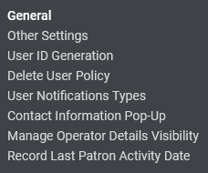
Step 1 Define the specific user notification
Define the specific user notification at "Configuration > User Management > General > User Notification Types".
The notification will later appear in the job "Update/Notify Users"

Slide 7
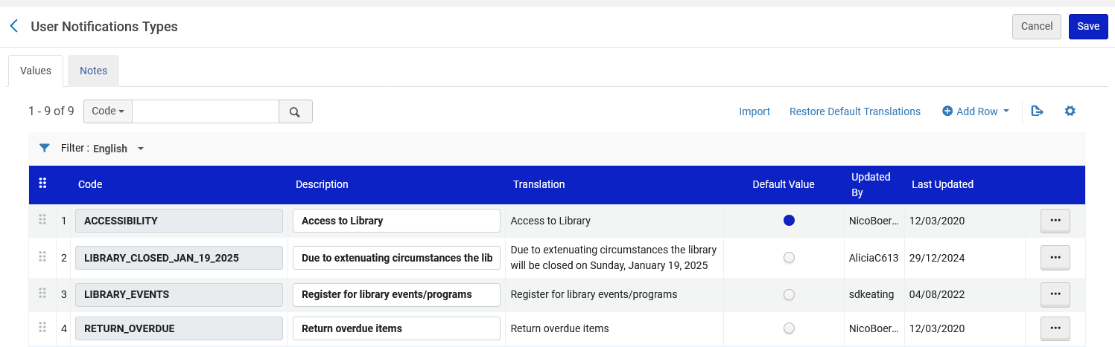
Step 1 Define the specific user notification
We have created a notification with code LIBRARY_CLOSED_JAN_19_2025 and description "Due to extenuating circumstances the library will be closed on Sunday, January 19, 2025."

Slide 8
Step 2 Define messages for letter

Slide 9
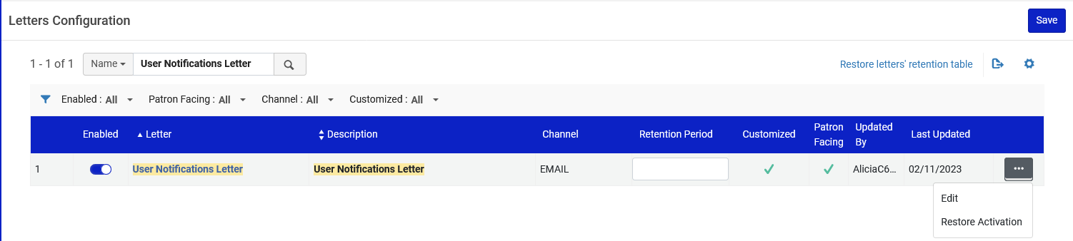
Step 2 Define messages for letter
Edit the "User Notifications Letter" at "Configuration > General > Letters > Letters Configuration"

Slide 10
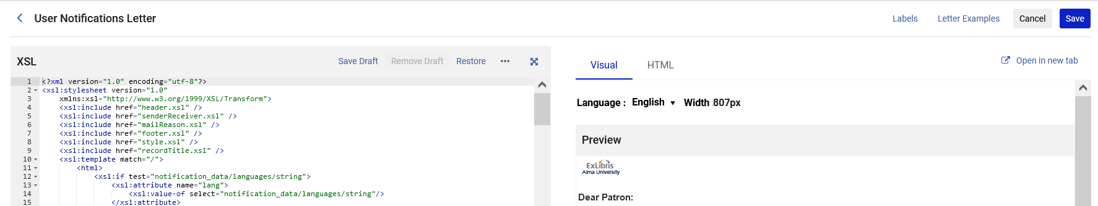
Step 2 Define messages for letter
Access the labels

Slide 11
Step 2 Define messages for letter
Define the lines and subject which will appear in the letter as desired.
We will define as follows:
Line_1 = Due to extenuating circumstances the library will be closed Sunday, Jan. 19.
Line_2 = Online access will still be available.
Line_3 = Thank you for your understanding.

Slide 12
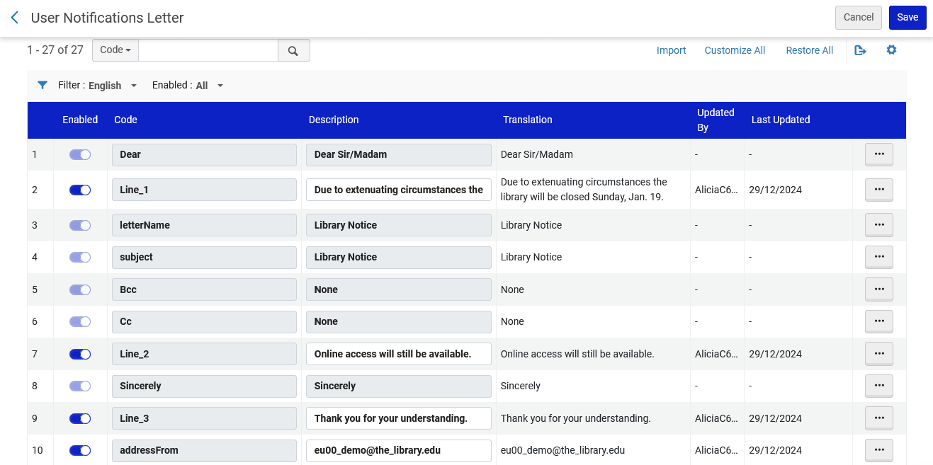
Step 2 Define messages for letter

Slide 13
Step 3 Edit the XSL of the letter

Slide 14
Step 3 Edit the XSL of the letter
Edit the XSL of the User Notifications Letter so that it will print the lines which we defined in step 2 in the labels.
The XSL of the User Notifications Letter needs the user notification type code added in step 1 (this is instead of or in addition to the condition already in the letter).
Delete or comment out any other unnecessary information in the XSL of the User Notifications Letter (for example, there is reference in the default letter to a password, because the letter can also be used to notify patrons of their password).
By default, only line 1 and 2 from the labels will appear in the User Notifications Letter. If it is desired that another line (such as line 3) will appear in the letter then it must be added.

Slide 15
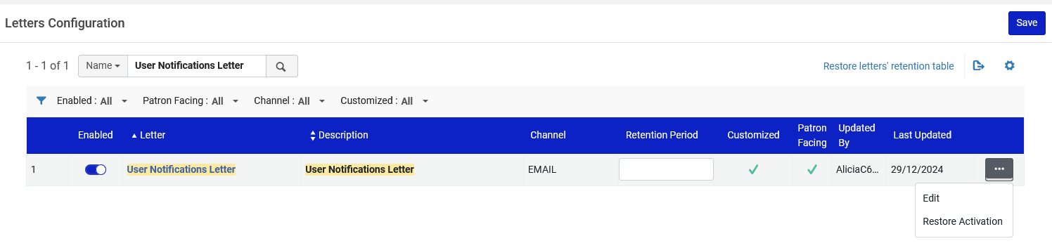
Step 3 Edit the XSL of the letter

Slide 16
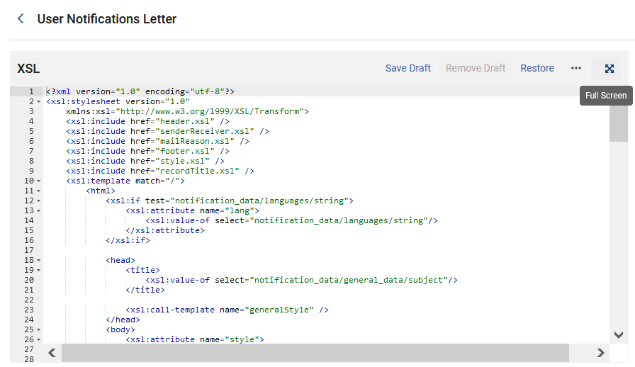
Step 3 Edit the XSL of the letter
Put the XSL in Full Screen for easier editing

Slide 17
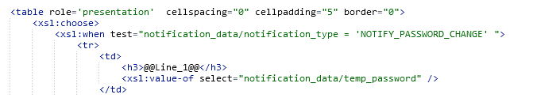
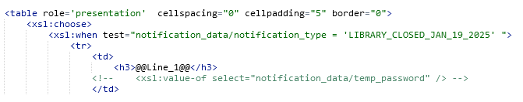
Step 3 Edit the XSL of the letter
Change this
The notification type code defined in step 1
To this
Comment out the appearance of the password

Slide 18
Step 3 Edit the XSL of the letter
The user notification type code added in step 1 as it appears in the XSL of the letter.

Slide 19
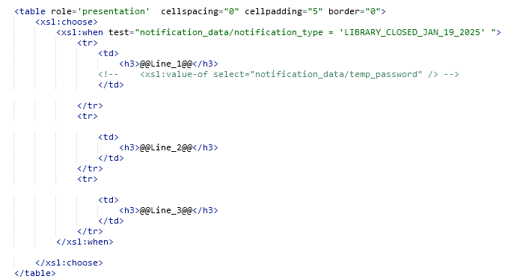
Step 3 Edit the XSL of the letter
Add whatever additional lines are needed.
@@Line_1@@ and @@Line_2@@ already existed.
We added @@Line_3@@.
These lines were defined previously in the labels.

Slide 20
Step 4 Define a set of users to receive letter

Slide 21
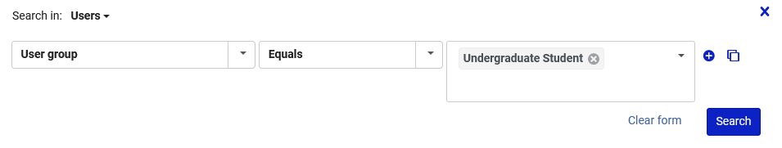
Step 4 Define a set of users to receive letter
We will make a set of users with user group "Undergraduate Student"

Slide 22
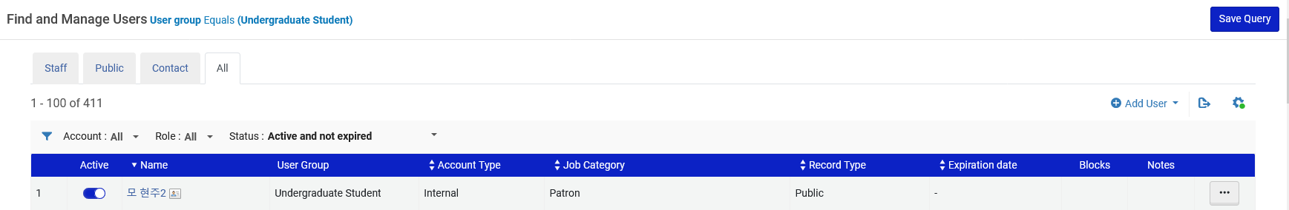
Step 4 Define a set of users to receive letter
The set will include users who are active and not expired.

Slide 23
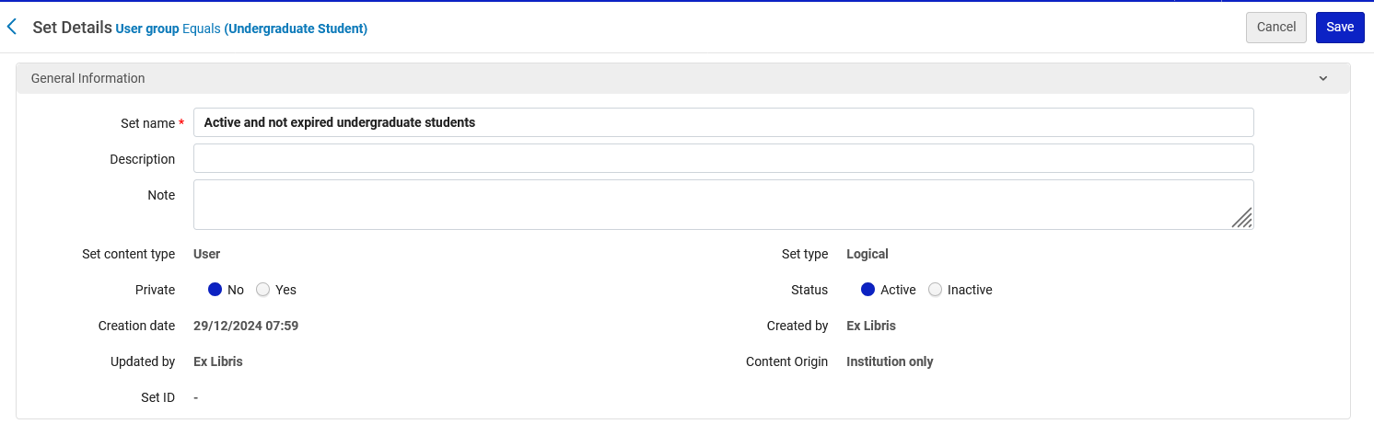
Step 4 Define a set of users to receive letter
The set is named "Active and not expired undergraduate students"

Slide 24
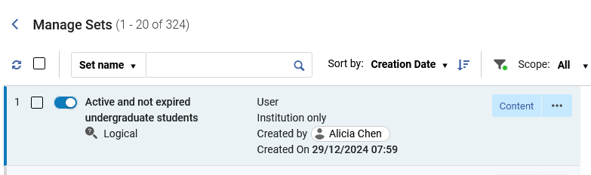
Step 4 Define a set of users to receive letter
The set is named "Active and not expired undergraduate students"

Slide 25
Step 5 Run the job "Update/Notify Users"

Slide 26
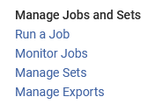
Step 5 Run the job "Update/Notify Users"
Access the job "Update/Notify Users" at "Admin > Manage Jobs and Sets > Run a Job"

Slide 27
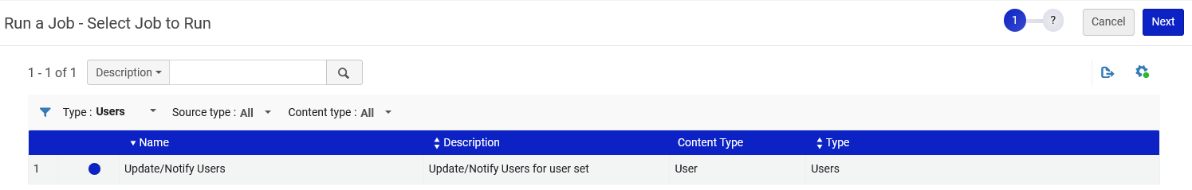
Step 5 Run the job "Update/Notify Users"
Select the job "Update/Notify Users" and click "Next"

Slide 28
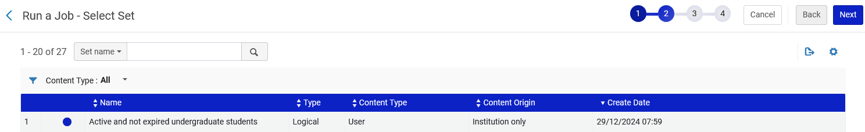
Step 5 Run the job "Update/Notify Users"
Select the desired set of users and click "Next"

Slide 29
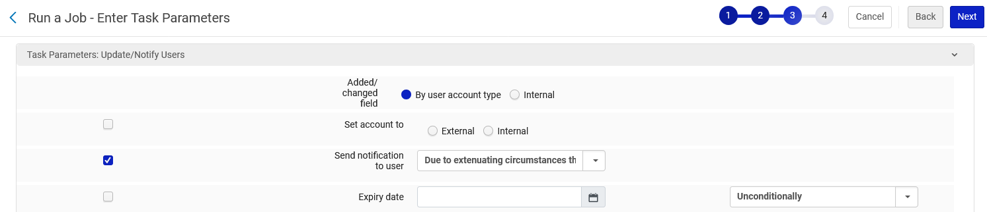
Step 5 Run the job "Update/Notify Users"
Check the box next to "Send notification to user".
In the field "Send notification to user" select the notification which is the description of the notification defined in step 1.
Click "Next"

Slide 30
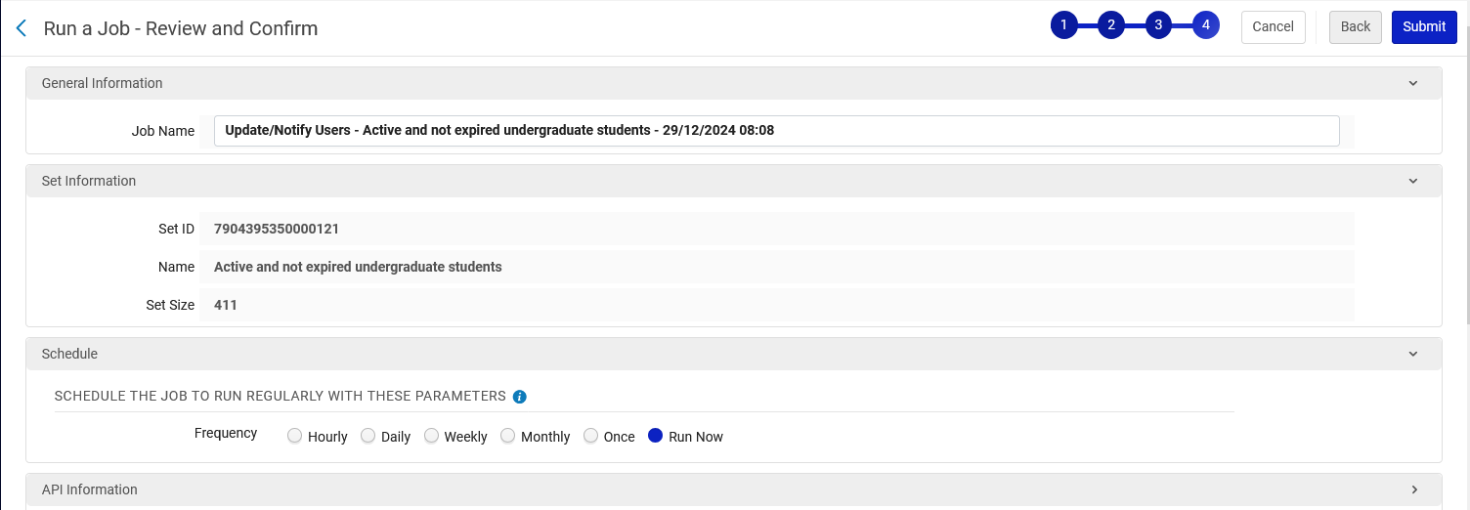
Step 5 Run the job "Update/Notify Users"
Submit the job

Slide 31
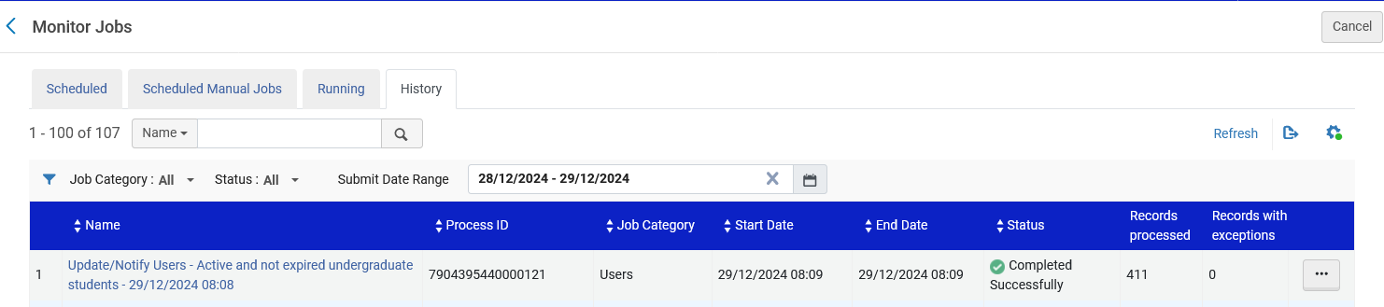
Step 5 Run the job "Update/Notify Users"
The job completes

Slide 32
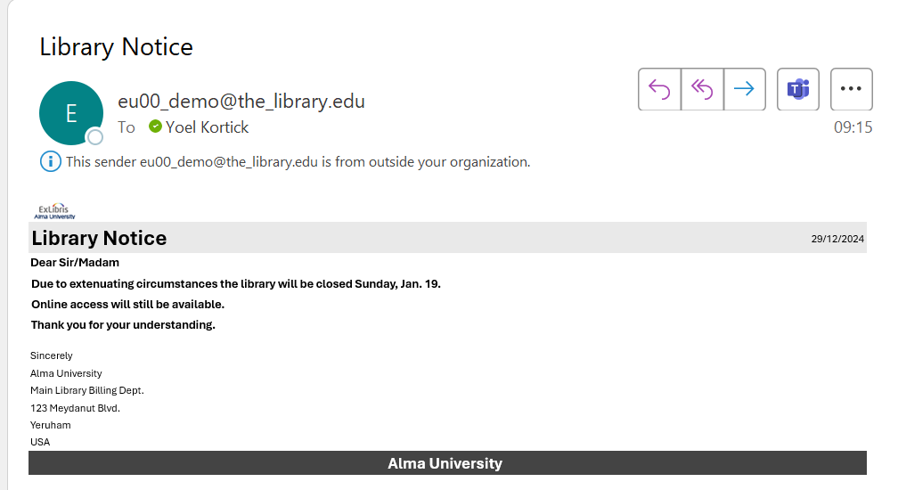
Step 5 Run the job "Update/Notify Users"
The letter is sent to the users in the set.
The letter includes the text from the labels.
The formatting of the letter is from the XSL of the letter.

